Slide 1

2-D Helicopter Game
Div: CS_B
Group-No: SY-29
Date:26th April 2024
Day : Friday
Krushna Gore | 12211656
Kartarsingh Gothwal | 12210284
Tanvi Gunjal | 12211632
Sejal Hage | 12210494
Project Guide:
Prof . Archana Burujwale
Vishwakarma Institute of Technology , Pune
Department of Computer Engineering

Slide 2
Introduction
A 2-D helicopter game using OpenGL is a video game where players control a helicopter navigating through a 2-dimensional environment. Players typically use keyboard or touch controls to maneuver the helicopter vertically and horizontally, avoiding obstacles and enemies while collecting power-ups or bonuses. The game's graphics and animations are rendered using OpenGL, allowing for smooth and visually appealing visuals.

Slide 3
Objectives
Develop intuitive controls and challenging obstacles for the helicopter game.
Render high-quality 2-D graphics and smooth animations using OpenGL.
Create a user-friendly interface with clear feedback and scoring mechanisms.
Optimize performance for smooth gameplay on various platforms.
Ensure cross-platform compatibility for desktop and mobile devices.
Incorporate user feedback to iteratively improve the game's mechanics and experience.

Slide 4
Plan of Action
Conceptualization and Design
OpenGL Setup and Environment Development
Helicopter Movement and Interaction
Obstacle Generation and Gameplay Challenges
User Interface, Feedback, and Polish

Slide 5
Literature Survey
Sr No | Book Name | Authors | Abstract
1 | Teaching Undergraduate Computer Graphics: Game Design and Implementation Utilizing the OpenGL Library and the Windows API (Article) | Chao Zhao; Mike Estep; Feridoon Moinian | https://ieeexplore.ieee.org/abstract/document/8560970
2 | OpenGL Game Development By Example (Book) | Robert Madsen, Stephen Madsen | https://www.google.co.in/books/edition/OpenGL_Game_Development_By_Example/PETiCwAAQBAJ?hl=en&gbpv=1&dq=computer+graphics+programming+in+opengl+to+develop+a+game&pg=PP1&printsec=frontcover
3 | Interpretive OpenGL for computer graphics (Article) | Bo Chen, Harry H. Cheng | https://www.sciencedirect.com/science/article/abs/pii/S0097849305000415

Slide 6
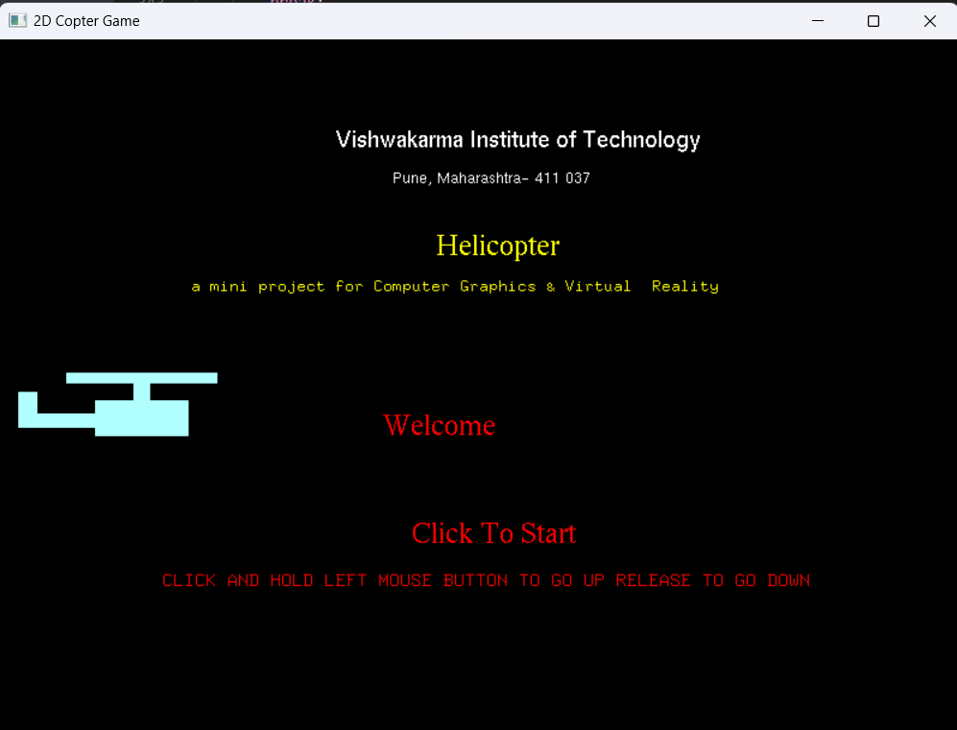
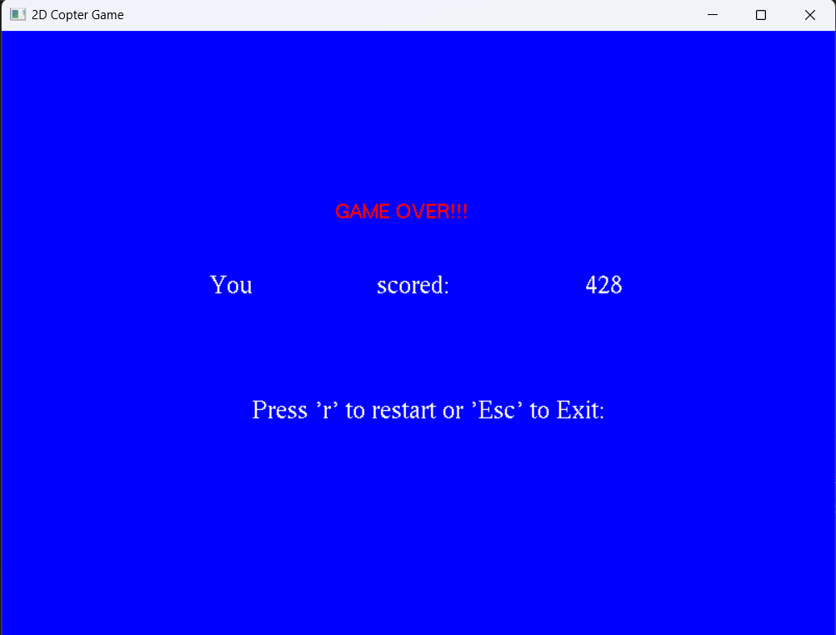
Welcome Window
Game Over Window

Slide 7
Conclusion
In summary, developing a 2-D helicopter game using OpenGL enables us to create an immersive experience with visually stunning graphics, smooth animations, and intuitive controls. By optimizing performance and incorporating user feedback, we ensure an engaging and enjoyable experience across platforms. This journey promises a rewarding endeavor in delivering memorable gaming experiences to players worldwide.

Slide 8
THANK YOU!!

